Slide 1
UTSA CS 4593: CS-CURE
Course-based Undergraduate Research Experience in CS
Amanda Fernandez, Ph.D
UTSA Department of Computer Science
Spring 2024

Slide 2
Week 2: Research Basics

Slide 3
UTSA CS-CURE
Week 2
Objectives:
Identify potential topics of research interest within your field
Learn to search for relevant research themes in a field
Learn about basic research tools for use this semester
Deliverables:
SIG Meeting 0 (in class on Thursday)
Activity 2 (in class on Thursday)

Slide 4
UTSA CS-CURE
Week 2
Today:
Topics: tools & basic research
Looking ahead in the semester
Research proposals & project info

Slide 5
Identifying Research Topics
Getting started in new fields
Example:
Artificial Intelligence / Machine Learning
Explainable AI
Deep learning models are not easily interpretable, which is problematic for some applications (e.g. healthcare)
Integrated gradients attempt to explain why a model classifies an input as it does, by comparing it with a baseline input.
Terms:
field = area within CS
topic = concept within the field
problem = specific focus within the topic
approach = unique methods for addressing the problem

Slide 6
Identifying Research Topics
Getting started in new fields
Example:
Data science
Visualization & HCI (human-computer interaction)
Visualizing real-time data streams can be overwhelming in the amount of data and therefore not useful to the user.
Leverage data reduction techniques* in combination with AR/VR for live integration of data with relevant user tools (e.g. heads-up displays HUDs while driving)
Terms:
field = area within CS
topic = concept within the field
problem = specific focus within the topic
approach = unique methods for addressing the problem
….so where do we start?
*be more specific!

Slide 7
Identifying Research Topics
Getting started in new fields
Find relevant research communities
Review recent work/questions in the field
Types of conferences & meetings
Types of publications
How to read a research paper
Plug yourself into the community
Join the groups, meetings, etc.
Automate your research

Slide 8
Beginning Research:
Basic Tools
Advanced tools coming soon!

Slide 9
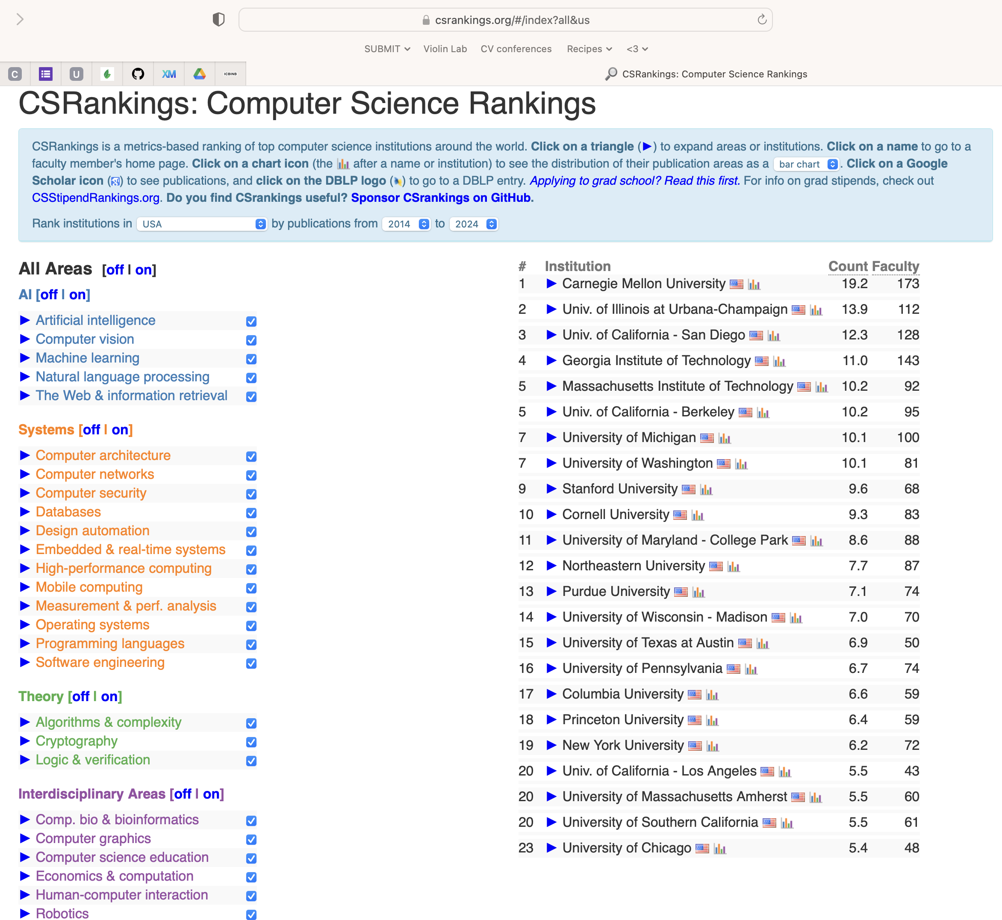
CS Rankings
csrankings.org
Listing of top conferences & universities by field.
Useful for:
searching for a graduate program/advisor
identifying top conferences.

Slide 10
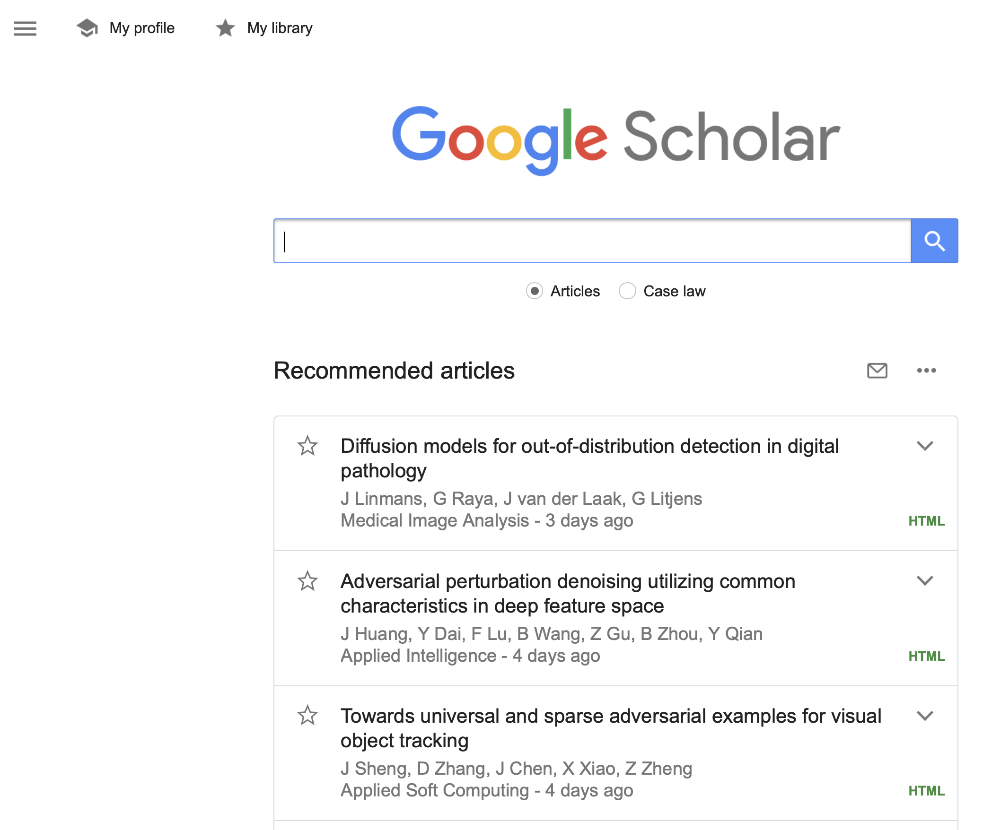
Google Scholar
scholar.google.com
Search engine specializing in research - papers and profiles.
Useful for:
free paper access
finding researchers
passive research (save articles & it recommends more).

Slide 11
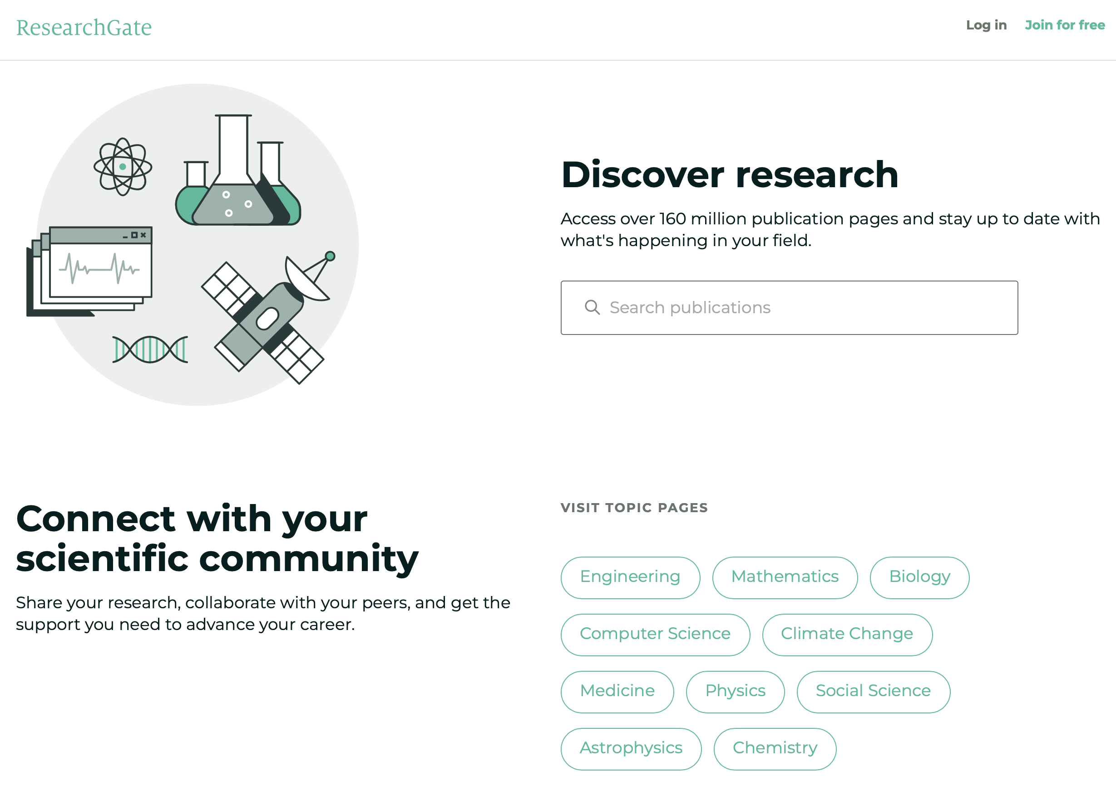
ResearchGate
researchgate.net
Social media-like platform (profiles, newsfeed, messaging) for research.
Useful for:
networking
passive research - enter your interests & it “learns” what new papers might be of interest.

Slide 12
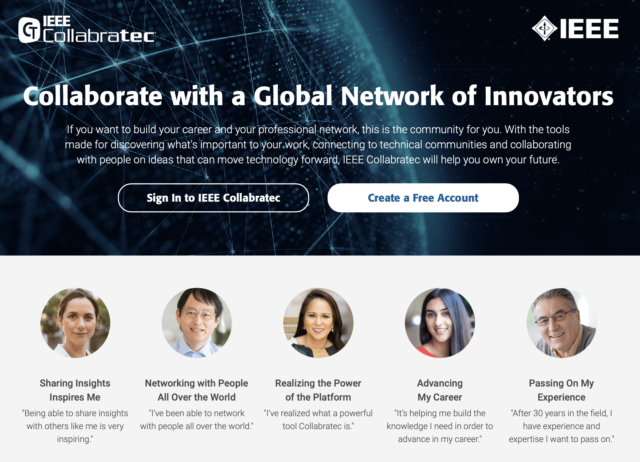
IEEE Collabratec
ieee-collabratec.ieee.org
Social media-like platform (profiles, newsfeed, messaging).
Useful for:
networking
searching for a graduate advisor
job search

Slide 13
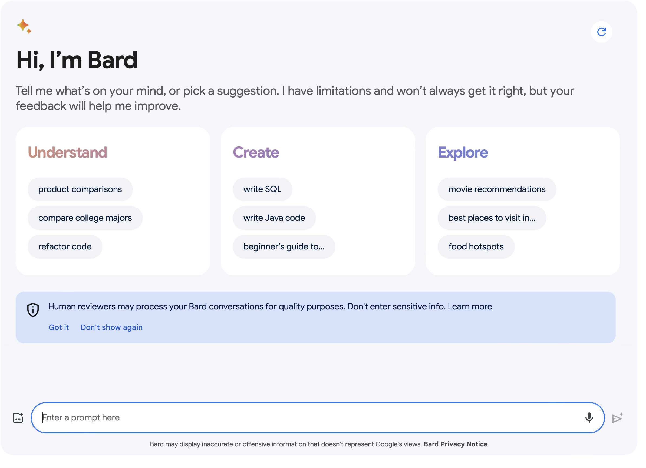
AI for Research
Tools
LLMs are very helpful, but also very prone to hallucination (inferring invalid information when exact answers aren’t available).
Plenty of free options…
Google Bard
OpenAI ChatGPT 3.5
I like…
Perplexity (free mobile app for GPT 3.5)
listening.io (paid mobile app for listening to research papers)

Slide 14
AI for Research
Do’s & Don’ts
Do:
Start a chat about your research field/topics of interest.
Verify any “facts” it provides.
Download an app for easy access.
Get specific & ask for help creating presentations, etc.
Don’t:
Cite any LLM as a source.
Pay for a service just for research (not worth it, yet!)
Upload any material from any class, research, or employer.
Generate anything you were supposed to write.
Fall for the “made easy” services (e.g. for summarization, etc)

Slide 15

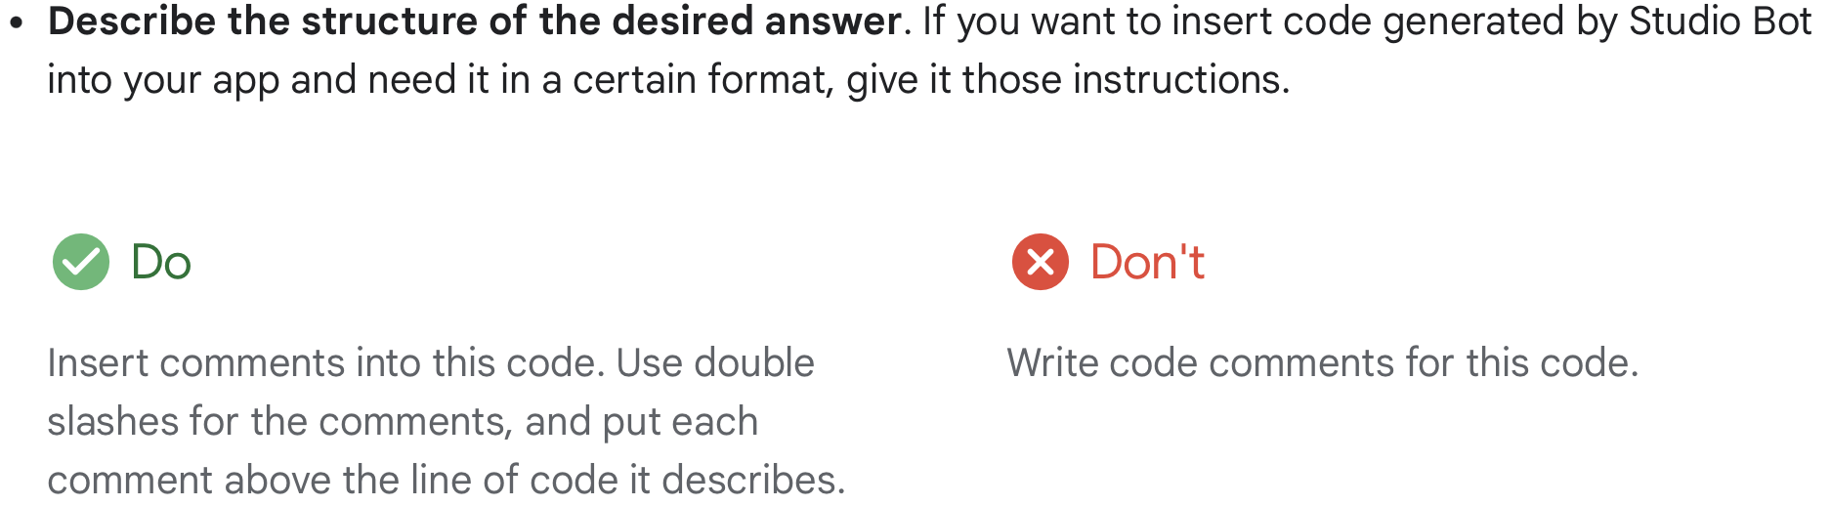
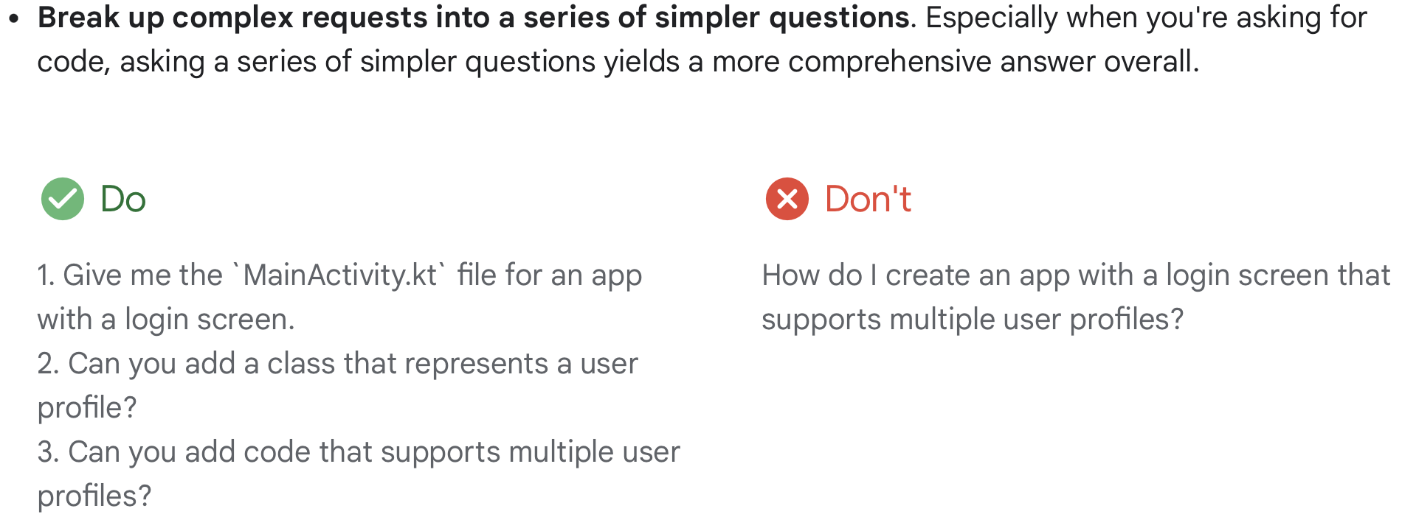
AI for Research
Prompt Engineering
It’s important to format your prompt to the LLM in a way which optimizes your desired response.
Consider the task and subtasks, ask for what you need.
Learn the general guidelines for interacting with an AI to optimize your time.
Remember: it’s a conversation,
not a one-time search query!
Source: Studio Bot

Slide 16
AI for Research
Prompt Engineering
Find research in data science.
Describe the task
Describe the context
Provide examples of preferred results
Provide some details
Continue the conversation (do not look for the “optimal” single search)
I’m interested in research in data science.
What topics should I get started with?
List open problems in the field, along with a link to a relevant tutorial or blog for each.

Slide 17
AI for Research
Getting started (fill in your research field/topic!)
Who are some of the top researchers in the field of __________ ?
What are some good tutorials for getting started on __________ ?
Generally when are the conferences on __________ held?

Slide 18
Beginning Research:
Finding Relevant Themes
Continues next week!

Slide 19
Identifying Research Topics
Getting started in new fields
Find relevant research communities
Review recent work/questions in the field
Types of conferences & meetings
Types of publications
How to read a research paper
Plug yourself into the community
Join the groups, meetings, etc.
Automate your research

Slide 20
Identifying Research Topics
Beginning Research
Resources for keeping up with the SOTA in your field
SIGs - ACM, IEEE, …?
Meetings - conferences, workshops, symposia, etc.
Papers - proceedings from conferences, journal papers
Other technical content
Blogs
Code repositories (repos)
SOTA = state-of-the-art

Slide 21
Feature | Conference | Workshop | Symposium
Frequency | Held annually or biannually | Typically one-time events, though some may recur annually | One-time events, often focused on a specific topic or issue
Size | Large, with hundreds or even thousands of attendees | Smaller, with typically fewer than 100 attendees | Small, with usually less than 50 attendees
Scope | Broad, covering a wide range of topics within computer science | Narrow, focused on a specific research area or problem | Narrow, focused on discussing and debating a specific issue or topic
Format | Presentations, tutorials, panels, networking events | Hands-on activities, interactive sessions, demonstrations | Presentations, discussions, Q&A sessions
Target audience | Researchers, academics, industry professionals, students | Researchers, students, practitioners interested in a specific area | Experts, stakeholders, interested public
Goals | Disseminate research findings, share knowledge, network | Develop skills, brainstorm ideas, solve problems | Discuss and explore a specific issue, reach consensus or recommendations
Cost | Higher, due to larger size and venue | Lower, due to smaller size and simpler format | Variable, depending on organizer and format
Examples | CVPR, ICCV, NeurIPS | AI For Science (@NeurIPS), I Can’t Believe It’s Not Better (@NeurIPS) | Symposium on the Future of Artificial Intelligence, Symposium on Ethical Implications of Computing

Slide 22
Identifying Research Topics
Beginning Research
Types of Research Presentations
Technical Talks - presentations of research within the context of SOTA, including motivation, approach, experiments/evaluation.
Spotlights - short 5-10min technical talks
Lightning Talks - short 2-5min technical talks
Keynotes - presentations from established experts, often focused on a high-level look at the field and upcoming relevant themes/questions (rather than just their own research/findings). Usually 30min-1hr.
Invited Talks - presentations from established experts, focused on their own research.
Posters - scientific poster sessions with structured templates that reflect the research paper in visual format.
Panels - groups of experts providing different perspectives on a predetermined topic, moderated and with audience input.
BoF (birds of a feather) - typically a panel that is not moderated, more of a roundtable with less audience input.

Slide 23
Identifying Research Topics
Beginning Research
Call For Papers/Participation (CFP)
Invitation from an organization to submit work for peer review and publication.
For conferences/workshops/etc, also for presentation.
Includes: topics of interest to the community, dates, length, style, and all information authors need to participate in this meeting.

Slide 24
Identifying Research Topics
Beginning Research
How to Read a Research Paper
Find one relevant to you - if it’s in your field, you will care more :)
Leverage the structure - all papers follow a similar format!
abstract, introduction, related work, methods, results, conclusion, references
Read (skim) the abstract, introduction, & conclusion first, to get an idea of what the problem is at a high level.
Read the related work next to discover how others have already approached this problem.
Read the introduction again to put the new approach in context - what are they doing differently?
Read the rest of the paper only if you’re still interested in their approach.

Slide 25
Next week

Slide 26
Next week
Looking ahead…
Tuesday: Identifying research problems
Thursday: Guest Research Lecture - Dr. Sushil Prasad
Research Project: Proposals due! (2/3)

Slide 27
Research Project

Slide 28
Research Project
Guided research in your CS field
See Canvas for the “call for papers” (CFP)
Objectives:
Participate in a research community (low risk!)
Learn about the research process
End the semester with a solid research review of a relevant topic

Slide 29
Research Project
Guided research in your CS field
Which SIG will you participate in for the rest of the semester?
In 1 sentence, concisely state the topic you propose to research this semester.
In 1 sentence, concisely state why your chosen topic/problem is important.
Identify 3 specific problems/questions you would be interested in researching this semester. Limit them to 1 sentence each, and order them by preference (where 1st is your favorite). Your instructor will provide feedback on which may be most viable.
For each problem, cite 1 relevant research paper (it’s ok if the same paper fits more than 1 of your identified problems). The citation must be in the following format: author, title, conference/journal, year. Include a link if possible.
If you are working on research outside of this class disclose it here! Remember this project must be your own work.

Slide 30
Research Topic Proposal for CS Research Course: Exploring Possibilities
Since your students might be new to research, let's adjust the assignment to focus on exploring potential research topics and laying the groundwork for a strong project:
1. Broad Area of Interest: Briefly state the general area of computer science that interests you the most (e.g., artificial intelligence, cybersecurity, graphics, software engineering).
2. Initial Ideas: List 2-3 specific ideas within your chosen area that you find intriguing and would like to explore further. Briefly explain why each idea interests you.
3. Motivations and Questions: For each idea, identify one or two motivating questions that could potentially lead to a specific research question. Focus on understanding, curiosity, or potential application rather than formulated questions at this stage.
4. Initial Research Strategies: Briefly brainstorm 2-3 ways you could begin exploring each idea further. This could include searching for relevant papers, online resources, or talking to professors/experts in related fields.
5. Next Steps: Briefly outline your plan for the next phase of your research exploration. This could involve specific reading or activities you intend to do to refine your ideas and potentially formulate a research question.
Tips for Students:
Be open-minded and explore various avenues within your chosen area.
Don't worry about finding the "perfect" topic right away. Embrace the discovery process.
Focus on identifying interesting questions and potential contributions you could make.
Don't be afraid to seek guidance from professors, teaching assistants, or research librarians.
Use this assignment as a stepping stone to develop your research question and outline in the next phase.
Evaluation:
Assess the breadth and depth of student exploration within their chosen area.
Evaluate the potential and creativity of the proposed ideas and questions.
Consider the feasibility and practicality of the initial research strategies.
Provide constructive feedback to guide students in further narrowing their focus and refining their research direction.

Slide 31
Q&A

Slide 32
Wrap-Up
Tuesday
Tools for getting started in a new research field
Finding research topics within a field
To Do:
Decide on your research field (+ start thinking about topics)
See you Thursday!

Slide 33
SIG Meeting 0:
Getting Started

Slide 34
SIG Meeting 0
Getting Started
Form SIGs
Try to commit to a field this week!
Complete the group worksheet
Stay together for Activity 2…

Slide 35
Activity 2:
Identifying Research Problems

Slide 36
Activity 2: Identifying Research Problems
Thursday
Introduction
Finding relevant themes
Searching for gaps
In-class activity (turn in by end of class)
Wrap-up discussion

Slide 37
Activity 2: Identifying Research Problems
Finding Themes in Fields
The CFP for a SIG meeting can be reflective of the community’s research interests. It may include..
What topics are of interest (and specific problems)
What topics/problems that are not of interest
Also should include (or link to):
How long is the paper?
What format?
When is it due? When will it be reviewed & notified?
When is the meeting? Where?

Slide 38
Activity 2: Identifying Research Problems
Finding Themes in Fields
Part 1: Getting Specific About Topics in Your Field
Activity: SIG-specific flowcharts
Goal: answer fun questions to discover topics & problems of interest within your field (and importantly, what is not of interest)
Part 2: Discussions & Activity 2 Worksheet
Activity: complete the Activity 2 worksheet (to be turned in at the end of class)
Goal: discuss specific topics of interest among peers, discover larger (international) SIG peer communities & their resources, conferences/workshops.

Slide 39
Activity 2: Identifying Research Problems
Data Science
Are you captivated by the hidden gems within data? Do you want to unearth insights, predict trends, or solve crucial problems?
Perhaps another field within CS?
No
Congratulations! You've taken a step closer to finding your perfect data science subfield. Research specific topics within your chosen area!
Remember, data science is constantly evolving! Explore emerging areas like Explainable AI, Blockchain for Data Security, or Artificial Intelligence for Social Good.
Yes
Does the messy thrill of extracting knowledge from unlabeled data intrigue you?
Dive into Data Mining - discover patterns, anomalies, and relationships without predefined labels. Think market basket analysis, fraud detection, or customer segmentation.
Yes
No
Do you want to bridge the gap between data and real-world impact by building practical solutions?
Embark on the path of Data Science Applications - apply your knowledge to solve specific problems in diverse fields like healthcare, finance, or environmental science.
No
Yes
Do you crave the challenge of taming and analyzing massive datasets?
Conquer the frontier of Big Data - design pipelines, handle scalability, and extract meaningful insights from vast swathes of data. Think healthcare analytics, climate modeling, or financial risk assessment.
Yes
No
Does the ability to tell compelling stories with data through stunning visualizations excite you?
Become a skilled Data Visualization Expert - transform numbers into impactful charts, graphs, and dashboards that speak to all audiences.
Yes
No
Does the idea of shaping the future with responsible data practices resonate with you?
Champion the cause of Data Ethics - explore biases, privacy concerns, and the social impact of data-driven decisions. Design fairer algorithms and fight for ethical data use.
Yes
No
Are you fascinated by the power of predicting the future based on patterns in data?
Master the art of Machine Learning - build models that learn from data and make accurate predictions. Think recommendation systems, financial forecasting, or medical diagnosis.
No
Yes
Instructions: Beginning at the top, answer the questions (honestly!) to discover which research topics & problems might be of interest within your field. Circle the blue boxes that correspond with a good match to your answers, and cross out any that are not of interest. Leave the rest unmarked.
Question & response text has been edited by an LLM.

Slide 40
Activity 2: Identifying Research Problems
Computer Vision
Are you captivated by the world seen through the eyes of machines? Do you want to make computers understand pictures and videos?
Perhaps another field within CS? Explore options like natural language processing, robotics, or machine learning in general.
No
Yes
Dive into the realm of Image Segmentation - separate foreground objects from background, identify different parts of a scene, or extract specific regions of interest. Think medical image analysis, autonomous driving lane detection, or object-based image editing.
Dive deeper into your chosen subfield from earlier questions, or consider applications!
Perhaps explore specific applications within object detection, image segmentation, 3D vision, or generative models that align with your interests.
Remember, computer vision is constantly evolving! Explore emerging areas like Explainable AI for Vision Systems, Facial Recognition Ethics, or using Visual Data for Climate Change Monitoring.
Does the idea of dividing an image into distinct regions or objects fascinate you?
Yes
No
Explore the exciting world of Generative Models - train algorithms to generate realistic images, manipulate existing images, or even synthesize completely new visual content. Think art generation, creating realistic portraits, or generating realistic backgrounds for special effects.
Can you imagine machines creating entirely new images or videos?
Yes
No
Embark on the path of Robot Vision and SLAM - develop vision algorithms for robots to perceive their surroundings, avoid obstacles, and build maps of their environment. Think SLAM for drones, robotic object grasping, or self-driving car navigation.
Does the idea of building the eyes for robots and drones to navigate the world excite you?
Yes
No
Does the idea of teaching computers to "see" like humans fascinate you?
Dive into Object Detection and Recognition - train algorithms to identify objects, faces, and scenes in images and videos. Think self-driving cars, medical image analysis, or robot object manipulation.
Yes
No
Conquer the frontier of 3D Computer Vision - reconstruct 3D scenes from images, track objects in 3D space, or build augmented reality experiences. Think SLAM for drones, medical imaging with depth, or AR/VR applications.
Are you intrigued by the 3D world seen through computer eyes?
No
Yes
Instructions: Beginning at the top, answer the questions (honestly!) to discover which research topics & problems might be of interest within your field. Circle the blue boxes that correspond with a good match to your answers, and cross out any that are not of interest. Leave the rest unmarked.
Question & response text has been edited by an LLM.

Slide 41
Activity 2: Identifying Research Problems
Flip to back page!
Cybersecurity
Are you fascinated by protecting the digital world from malicious threats? Do you want to outwit attackers and keep data safe?
Perhaps another field within CS?
Explore options like software engineering, artificial intelligence, or game development.
Page 1/2
No
No
Does the thrill of the chase in network security excite you?
Embark on the path of Network Security and Defense - monitor network traffic, detect and prevent intrusions, and protect against vulnerabilities. Think intrusion detection systems, firewalls, and network anomaly detection.
Yes
Dive into the exciting realm of Digital Twins for Cybersecurity - develop and integrate digital models of critical infrastructure, test security scenarios virtually, and predict potential attacks. Think power grid cybersecurity, healthcare system simulations, and industrial control systems protection.
Yes
Does the idea of creating virtual replicas of physical systems to predict and prevent cyberattacks intrigue you?
Yes
No
Are you captivated by the art of building secure systems from the ground up?
Explore the world of Security Engineering - design secure systems, implement robust authentication and authorization mechanisms, and prevent vulnerabilities. Think secure coding practices, network security architecture, and cloud security.
No
Yes
Explore the frontier of Quantum Security - understand how quantum computing can break certain encryption algorithms, design post-quantum cryptography resistant to these threats, and build future-proof secure systems. Think quantum-resistant key exchange, secure communication protocols, and post-quantum network infrastructure.
Are you captivated by the unbreakable promise of quantum cryptography and its potential to revolutionize digital security?
Yes
No
Does the detective work of digital forensics intrigue you?
Dive into the realm of Incident Response and Forensics - analyze systems after an attack, gather evidence, and track down cybercriminals. Think network intrusion investigations, data breach analysis, and malware analysis.
Yes
No
Embark on the path of AI for Cyberdefense - develop and deploy AI-powered tools to detect anomalies, predict attacks, and automate threat response. Think intrusion detection systems powered by AI, malware analysis with machine learning, and autonomous security bots.
Can you imagine teaching machines to fight back against cyberattacks in real-time?
Yes
No
Explore Cybersecurity for Critical Infrastructure - assess vulnerabilities in power grids, transportation systems, & other critical systems, develop secure protocols and incident response plans, and safeguard national security. Think securing energy grids, protecting industrial control systems, & defending against targeted attacks on vital infrastructure.
Does the critical responsibility of protecting vital infrastructure from cyber threats excite you?
No
Yes
Instructions: Beginning at the top, answer the questions (honestly!) to discover which research topics & problems might be of interest within your field. Circle the blue boxes that correspond with a good match to your answers, and cross out any that are not of interest. Leave the rest unmarked.
Question & response text has been edited by an LLM.

Slide 42
Activity 2: Identifying Research Problems
Cybersecurity
Can you imagine hacking for good and protecting others from cyberattacks?
Explore the field of Offensive Security and Penetration Testing - ethically test systems for vulnerabilities, identify weaknesses, and recommend security improvements. Think penetration testing, vulnerability research, and red teaming.
Page 2/2
Yes
No
Does the human element of cybersecurity and social engineering fascinate you?
Discover the world of Social Engineering and User Security - understand how attackers manipulate people, educate users about cyber threats, and implement security awareness programs. Think phishing awareness training, social engineering research, and designing secure human-computer interaction.
Yes
No
Congratulations! You've narrowed down your interests in cybersecurity.
Remember, cybersecurity is constantly evolving!
Explore emerging areas like Blockchain for Secure Transactions, Zero-Trust Security Models, or Cybersecurity for the Metaverse.
Instructions: Beginning at the top, answer the questions (honestly!) to discover which research topics & problems might be of interest within your field. Circle the blue boxes that correspond with a good match to your answers, and cross out any that are not of interest. Leave the rest unmarked.
Question & response text has been edited by an LLM.

Slide 43
Activity 2: Identifying Research Problems
Systems
Are you fascinated by the complex machinery that underlies the digital world? Do you want to build, optimize, and understand how systems work together?
Perhaps another field within CS?
Flip to back page!
Page 1/2
No
No
Yes
Dive into the realm of Quantum Computing for Systems - explore novel algorithms and architectures enabled by quantum principles, optimize systems for quantum hardware, and design future-proof solutions. Think quantum cryptography, quantum simulation for systems optimization, and fault-tolerant quantum systems.
Are you intrigued by the invisible forces shaping distributed systems like the internet?
Explore the world of Distributed Systems and Networks - understand how systems communicate and work together across networks, design fault-tolerant architectures, and optimize distributed algorithms. Think cloud computing, microservices, and peer-to-peer networks.
Yes
Does the cutting-edge potential of quantum computing in revolutionizing systems design intrigue you?
Yes
No
Explore the frontier of Edge Computing for the Internet of Things - design systems that process data at the edge of networks, optimize resource usage on resource-constrained devices, and build secure and responsive IoT ecosystems. Think real-time data processing for wearables, edge analytics for smart homes, and decentralized control in distributed sensor networks.
No
Are you captivated by the decentralized world of edge computing and its potential to bring intelligence closer to the data?
Does the intricacy of operating systems and managing processes fascinate you?
Dive into the realm of Operating Systems and Systems Programming - understand the core principles of operating systems, write device drivers, and optimize system performance. Think kernel development, process management, and memory allocation.
Yes
Yes
No
Does the transparency and security offered by blockchain technology excite you in the context of system design?
Embark on the path of Blockchain for Distributed Ledger Technology - build systems that leverage blockchain for secure data storage and traceability, design reliable consensus mechanisms for distributed systems, and explore applications in areas like supply chain management and secure identity systems. Think tamper-proof audit logs for systems, decentralized energy grids with blockchain, and secure voting systems.
Explore the field of Cyber-Physical Systems for Smart Infrastructure - design systems that integrate computing and communication with physical components, develop control algorithms for complex systems like smart grids and autonomous vehicles, and ensure reliable and secure operation in critical infrastructure. Think intelligent traffic management systems, predictive maintenance for industrial systems, and secure control systems for power grids.
Yes
No
Can you imagine bridging the gap between the physical and digital worlds through cyber-physical systems?
No
Yes
Instructions: Beginning at the top, answer the questions (honestly!) to discover which research topics & problems might be of interest within your field. Circle the blue boxes that correspond with a good match to your answers, and cross out any that are not of interest. Leave the rest unmarked.
Question & response text has been edited by an LLM.

Slide 44
Activity 2: Identifying Research Problems
Systems
Does the challenge of keeping large systems reliable and available excite you?
Embark on the path of Systems Reliability and Performance - analyze system behavior, identify bottlenecks, and design measures to prevent failures and ensure efficient operation. Think failure analysis, performance optimization, and high-availability systems.
Page 2/2
Yes
No
Can you imagine building the infrastructure that powers the digital world from the ground up?
Explore the field of Computer Architecture and Hardware - understand the inner workings of processors, design efficient system architectures, and optimize hardware for specific tasks. Think parallel processing, chip design, and embedded systems.
Yes
No
Does the idea of managing and securing complex IT systems intrigue you?
Discover the world of Systems Administration and Security - install and configure systems, manage system accounts and access, and implement security measures to protect against threats. Think network administration, server management, and cybersecurity for systems.
Yes
No
Congratulations! You've narrowed down your interests in systems.
Remember, systems are everywhere!
Explore emerging areas like Machine Learning for System Optimization, Software-Defined Networking, or Explainable AI for Complex Systems.
Instructions: Beginning at the top, answer the questions (honestly!) to discover which research topics & problems might be of interest within your field. Circle the blue boxes that correspond with a good match to your answers, and cross out any that are not of interest. Leave the rest unmarked.
Question & response text has been edited by an LLM.

Slide 45
Activity 2: Identifying Research Problems
Algorithms/Quantum
Are you fascinated by the computational magic that solves problems? Do you want to design efficient instructions for computers to tackle real-world challenges?
Perhaps another field within CS?
Flip to back page!
Page 1/2
No
No
Are you fascinated by the power of algorithms in solving real-world challenges?
Explore the diverse field of Algorithmic Applications - apply algorithms to areas like machine learning, computer graphics, optimization, cryptography, and bioinformatics. Think image compression algorithms, recommendation systems, traffic routing algorithms, and DNA sequencing algorithms.
Yes
Yes
Dive into the realm of Algorithmic Design and Analysis - understand different complexity classes, optimize algorithms for performance, and design efficient strategies for diverse problems. Think sorting algorithms, graph algorithms, and dynamic programming.
Does the thrill of finding the fastest or most efficient solution motivate you?
Yes
No
Discover the world of Data Structures and Algorithms - learn how to choose and implement efficient data structures (like graphs, trees, and hash tables) for different algorithms, and understand the trade-offs between different approaches. Think binary search trees, linked lists, and heaps.
No
Does the beauty of elegant and concise solutions resonate with you?
Yes
Explore the world of Probabilistic and Randomized Algorithms - understand how randomness can improve performance, analyze expected running times, and design algorithms with probabilistic guarantees. Think Monte Carlo simulations, randomized search algorithms, and error-correcting codes.
Are you intrigued by the power of randomness in solving problems?
Yes
No
Embark on the path of Quantum Annealing - understand the principles of this optimization technique, explore applications in areas like logistics, financial modeling, and materials science, and compare it to other optimization algorithms. Think Ising Model simulations, spin glasses, and D-Wave quantum computers.
No
Can you imagine solving complex optimization problems beyond classical computers with quantum annealing?
Yes
Instructions: Beginning at the top, answer the questions (honestly!) to discover which research topics & problems might be of interest within your field. Circle the blue boxes that correspond with a good match to your answers, and cross out any that are not of interest. Leave the rest unmarked.
Question & response text has been edited by an LLM.

Slide 46
Activity 2: Identifying Research Problems
Algorithms/Quantum
Does the need for transparency and trust in AI algorithms intrigue you?
Dive into the realm of Explainable AI for Algorithm Transparency - understand the inner workings of complex AI models, develop methods to explain their decisions, and advocate for transparency in algorithmic systems. Think interpretable machine learning models, explainable reasoning frameworks, and human-centered explanations.
Page 2/2
Yes
No
Are you passionate about ensuring fairness and ethical considerations in algorithms?
Explore the field of Algorithmic Fairness for Addressing Bias - identify and mitigate biases in algorithmic systems, understand ethical implications of algorithms, and design algorithms that uphold fairness principles. Think counterfactual reasoning for fairness analysis, mitigating bias in AI models, and algorithmic discrimination detection.
Yes
No
Congratulations! You've narrowed down your interests in algorithms.
Remember, algorithms are constantly evolving! Explore emerging areas like Algorithmic Optimization for AI, Quantum Machine Learning, or Natural Language Processing with Neural Networks.
Instructions: Beginning at the top, answer the questions (honestly!) to discover which research topics & problems might be of interest within your field. Circle the blue boxes that correspond with a good match to your answers, and cross out any that are not of interest. Leave the rest unmarked.
Question & response text has been edited by an LLM.

Slide 47
Activity 2: Identifying Research Problems
AI Applications
Are you passionate about leveraging AI to tackle real-world challenges and building intelligent systems that make a difference?
Perhaps another field within CS?
Flip to back page!
Page 1/2
No
Embark on the path of AI for Computer Science Education - develop intelligent tutoring systems, personalized learning platforms, and automated code grading tools, contribute to breakthroughs in areas like adaptive learning, student engagement, and virtual lab simulations. Think AI-powered tutors that answer student questions and provide feedback, adaptive courseware that adjusts to individual learning pace, and AI-based code graders that offer personalized feedback.
No
Yes
Can you imagine using AI to transform and personalize computer science education?
Yes
Dive into the realm of AI for Security and Threat Detection - develop algorithms for anomaly detection, cyber-attack prevention, and fraud analysis, explore advancements in areas like biometric authentication, network security, and secure communication. Think detecting malicious content in images, predicting cyberattacks on critical infrastructure, and developing AI-powered firewalls.
Does the potential of AI to safeguard our world excite you?
Yes
Explore the field of AI for Agriculture - develop AI systems for crop yield prediction, disease detection in plants, and precision agriculture management, contribute to solutions in areas like livestock health monitoring, soil optimization, and robotic farming. Think AI-powered robots identifying diseased crops, predictive models for optimal watering and fertilization, and AI-driven analysis of satellite imagery for agricultural management.
No
No
Are you passionate about applying AI to improve food production and sustainability in agriculture?
Yes
Are you fascinated by the idea of using AI to revolutionize the construction industry?
Explore the world of AI for Construction Science - develop AI systems for robot-assisted construction, automated construction site monitoring, and optimized project planning, contribute to areas like material selection, risk assessment, and construction safety. Think AI-powered construction robots, drones surveying and inspecting construction sites, and AI-driven construction scheduling software.
Yes
Discover the world of Generative AI for Creative Content Creation - develop AI models for music composition, video editing, and text generation, contribute to innovations in areas like personalized art platforms, AI-generated marketing campaigns, and virtual reality experiences. Think AI-powered music composers, video editing tools that suggest cuts and transitions, and AI-written scripts for video games.
No
No
Does the artistic potential of AI to generate creative content intrigue you?
Yes
Instructions: Beginning at the top, answer the questions (honestly!) to discover which research topics & problems might be of interest within your field. Circle the blue boxes that correspond with a good match to your answers, and cross out any that are not of interest. Leave the rest unmarked.
Question & response text has been edited by an LLM.

Slide 48
Activity 2: Identifying Research Problems
AI Applications
Does the mystery of the universe and the potential of AI to unlock its secrets excite you?
Explore the field of AI for Physics and Scientific Discovery - develop AI models for data analysis, anomaly detection, and hypothesis generation in physics experiments, contribute to breakthroughs in areas like particle physics simulations, astrophysical data analysis, and material science discovery. Think AI-powered telescopes analyzing astronomical data, AI models explaining particle collisions in accelerators, and AI-driven material property prediction for next-generation technologies.
Page 2/2
Yes
No
Congratulations! You've narrowed down your interests in AI applications.
Analyze specific subfields within your chosen area and identify research problems that align with your skills and passion!
Remember, AI applications are constantly evolving! Explore emerging areas like AI for Personalized Education, Explainable AI for Transparent decision-making, or AI for Climate Change Mitigation.
Can you imagine building intelligent systems that interact with the physical world through robots and automation?
Embark on the path of Robotics and Intelligent Control - develop algorithms for robot vision, navigation, and manipulation, build autonomous systems for tasks like object grasping, path planning, and collaborative robotics. Think multi-agent systems, industrial robots with AI vision, drones navigating complex environments, and collaborative robots assisting humans in healthcare.
Yes
No
Does the idea of using AI to improve human health and well-being motivate you?
Explore the field of AI for Healthcare and Medicine - develop AI systems for medical image analysis, disease prediction, and personalized healthcare, contribute to breakthroughs in areas like drug discovery, medical diagnosis, and patient care. Think medical image classification for early disease detection, AI-powered medical diagnosis tools, and virtual assistants for mental health support.
Discover the world of AI for Social Good and Sustainability - develop AI systems for tasks like disaster management, climate change mitigation, and resource optimization, contribute to solving global challenges and building a more sustainable future. Think AI-powered systems for predicting natural disasters, optimizing energy grids for sustainability, and analyzing social media data for public good.
Yes
No
No
Are you intrigued by the potential of AI to transform entire industries and revolutionize society?
Yes
Instructions: Beginning at the top, answer the questions (honestly!) to discover which research topics & problems might be of interest within your field. Circle the blue boxes that correspond with a good match to your answers, and cross out any that are not of interest. Leave the rest unmarked.
Question & response text has been edited by an LLM.

Slide 49
Activity 2: Identifying Research Problems
AI Ethics/Fairness
Are you concerned about the moral implications of artificial intelligence? Do you want to ensure AI systems are fair, responsible, and beneficial to society?
Perhaps another field within CS?
Flip to back page!
Page 1/2
No
No
Discover the world of Algorithmic Justice Movements - understand the impact of AI on marginalized groups, join social movements seeking algorithmic fairness, and advocate for responsible AI development for all. Think data activism, community-driven approaches to AI fairness, and policy advocacy for ethical AI.
Are you passionate about fighting for marginalized communities in the face of algorithmic injustice?
Yes
Yes
Dive into the realm of Algorithmic Bias and Fairness - learn to identify and mitigate bias in data, models, and algorithms, understand fairness metrics, and design algorithms that promote equitable outcomes. Think counterfactual reasoning for fairness analysis, mitigating bias in machine learning models, and algorithmic discrimination detection.
Does the potential for bias in AI algorithms intrigue you?
Yes
No
Explore the field of AI and Society - analyze the economic, social, and political implications of AI, contribute to responsible development and deployment of AI, and advocate for ethical considerations in AI adoption. Think job displacement due to automation, AI for social good, and ethical frameworks for AI governance.
No
Does the potential impact of AI on jobs and the future of work excite you?
Yes
Explore the world of AI and Privacy - understand the ethical implications of data collection, analysis, and use by AI systems, advocate for responsible data governance, and design privacy-preserving AI solutions. Think anonymization techniques, differential privacy, and explainable AI for transparency.
Are you fascinated by the ethical issues surrounding privacy and surveillance in AI?
Yes
Embark on the path of Explainable AI and Human-AI Interaction - develop methods to explain how AI systems make decisions, design interfaces that foster trust and understanding between humans and AI, and promote user control over AI technologies. Think interpretable machine learning models, explainable reasoning frameworks, and responsible chatbot design.
No
No
Can you imagine building trust and transparency in AI systems?
Yes
Instructions: Beginning at the top, answer the questions (honestly!) to discover which research topics & problems might be of interest within your field. Circle the blue boxes that correspond with a good match to your answers, and cross out any that are not of interest. Leave the rest unmarked.
Question & response text has been edited by an LLM.

Slide 50
Activity 2: Identifying Research Problems
AI Ethics/Fairness
Does the design of AI systems from a human-centered perspective intrigue you?
Dive into the realm of Human-Centered AI Design - understand the needs and expectations of users, design AI systems that are accessible, inclusive, and user-friendly, and promote responsible human-AI collaboration. Think inclusive design principles for AI, user experience research with AI, and designing for trust and empowerment.
Page 2/2
Yes
No
Can you imagine the ethical challenges and opportunities presented by emerging technologies like quantum computing?
Explore the field of Quantum Computing and its Ethical Implications - understand the unique ethical considerations of quantum AI, analyze potential impacts on privacy, security, and fairness, and contribute to responsible development and governance of quantum technologies. Think quantum cryptography and its impact on privacy, bias in quantum algorithms, and responsible AI governance frameworks.
Yes
No
Congratulations! You've narrowed down your interests in AI ethics and fairness.
Remember, AI ethics and fairness is a rapidly evolving field!
Explore emerging areas like Algorithmic Accountability Frameworks, Explainable AI for Explainable Policies, or AI for Global Public Good.
Instructions: Beginning at the top, answer the questions (honestly!) to discover which research topics & problems might be of interest within your field. Circle the blue boxes that correspond with a good match to your answers, and cross out any that are not of interest. Leave the rest unmarked.
Question & response text has been edited by an LLM.

Slide 51
Activity 2: Identifying Research Problems
?
1
Perhaps another field within CS?
Flip to back page!
Page 1/2
No
No
Yes
6
?
Yes
2
?
Yes
No
No
5
?
Yes
3
?
Yes
No
No
4
?
Yes
Instructions: Beginning at the top, answer the questions (honestly!) to discover which research topics & problems might be of interest within your field. Circle the blue boxes that correspond with a good match to your answers, and cross out any that are not of interest. Leave the rest unmarked.
Question & response text has been edited by an LLM.

Slide 52
Activity 2: Identifying Research Problems
?
7
?
Page 2/2
Yes
Congratulations
No
8
?
Yes
No
No
11
?
Yes
9
?
Yes
No
No
10
?
Yes
Instructions: Beginning at the top, answer the questions (honestly!) to discover which research topics & problems might be of interest within your field. Circle the blue boxes that correspond with a good match to your answers, and cross out any that are not of interest. Leave the rest unmarked.
Question & response text has been edited by an LLM.

Slide 53
Activity 2: Identifying Research Problems
?
1
Perhaps another field within CS?
No
8
?
Yes
?
2
?
Yes
No
7
?
No
Yes
3
?
Yes
No
6
?
Yes
No
4
?
Yes
No
5
?
No
Yes
Instructions: Beginning at the top, answer the questions (honestly!) to discover which research topics & problems might be of interest within your field. Circle the blue boxes that correspond with a good match to your answers, and cross out any that are not of interest. Leave the rest unmarked.
Question & response text has been edited by an LLM.

Slide 54
Data Science
Start: Are you captivated by the hidden gems within data? Do you want to unearth insights, predict trends, or solve crucial problems?
Yes: Go to Question 1
No: Perhaps another field beckons! Explore different branches of computer science to find your passion.
Question 1: Does the messy thrill of extracting knowledge from unlabeled data intrigue you?
Yes: Dive into Data Mining - discover patterns, anomalies, and relationships without predefined labels. Think market basket analysis, fraud detection, or customer segmentation.
No: Go to Question 2
Question 2: Do you crave the challenge of taming and analyzing massive datasets?
Yes: Conquer the frontier of Big Data - design pipelines, handle scalability, and extract meaningful insights from vast swathes of data. Think healthcare analytics, climate modeling, or financial risk assessment.
No: Go to Question 3
Question 3: Does the idea of shaping the future with responsible data practices resonate with you?
Yes: Champion the cause of Data Ethics - explore biases, privacy concerns, and the social impact of data-driven decisions. Design fairer algorithms and fight for ethical data use.
No: Go to Question 4
Question 4: Are you fascinated by the power of predicting the future based on patterns in data?
Yes: Master the art of Machine Learning - build models that learn from data and make accurate predictions. Think recommendation systems, financial forecasting, or medical diagnosis.
No: Go to Question 5
Question 5: Does the ability to tell compelling stories with data through stunning visualizations excite you?
Yes: Become a skilled Data Visualization Expert - transform numbers into impactful charts, graphs, and dashboards that speak to all audiences.
No: Go to Question 6
Question 6: Do you want to bridge the gap between data and real-world impact by building practical solutions?
Yes: Embark on the path of Data Science Applications - apply your knowledge to solve specific problems in diverse fields like healthcare, finance, or environmental science.
No: Congratulations! You've taken a step closer to finding your perfect data science subfield. Research specific topics within your chosen area!
Bonus: Remember, data science is constantly evolving! Explore emerging areas like Explainable AI, Blockchain for Data Security, or Artificial Intelligence for Social Good.

Slide 55
Computer Vision
Start: Are you captivated by the world seen through the eyes of machines? Do you want to make computers understand pictures and videos?
Yes: Go to Question 1
No: Perhaps another branch of AI beckons! Explore options like natural language processing, robotics, or machine learning in general.
Question 1: Does the idea of dividing an image into distinct regions or objects fascinate you?
Yes: Dive into the realm of Image Segmentation - separate foreground objects from background, identify different parts of a scene, or extract specific regions of interest. Think medical image analysis, autonomous driving lane detection, or object-based image editing.
No: Go to Question 2
Question 2: Can you imagine machines creating entirely new images or videos?
Yes: Explore the exciting world of Generative Models - train algorithms to generate realistic images, manipulate existing images, or even synthesize completely new visual content. Think art generation, creating realistic portraits, or generating realistic backgrounds for special effects.
No: Go to Question 3
Question 3: Does the idea of teaching computers to "see" like humans fascinate you?
Yes: Dive into Object Detection and Recognition - train algorithms to identify objects, faces, and scenes in images and videos. Think self-driving cars, medical image analysis, or robot object manipulation.
No: Go to Question 4
Question 4: Are you intrigued by the 3D world seen through computer eyes?
Yes: Conquer the frontier of 3D Computer Vision - reconstruct 3D scenes from images, track objects in 3D space, or build augmented reality experiences. Think SLAM for drones, medical imaging with depth, or AR/VR applications.
No: Go to Question 5
Question 5: Does the idea of building the eyes for robots and drones to navigate the world excite you?
Yes: Embark on the path of Robot Vision and SLAM - develop vision algorithms for robots to perceive their surroundings, avoid obstacles, and build maps of their environment. Think SLAM for drones, robotic object grasping, or self-driving car navigation.
No: Dive deeper into your chosen subfield from earlier questions! Perhaps explore specific applications within object detection, image segmentation, 3D vision, or generative models that align with your interests.
Bonus: Remember, computer vision is constantly evolving! Explore emerging areas like Explainable AI for Vision Systems, Facial Recognition Ethics, or using Visual Data for Climate Change Monitoring.

Slide 56
Cybersecurity
Start: Are you fascinated by protecting the digital world from malicious threats? Do you want to outwit attackers and keep data safe?
Yes: Go to Question 1
No: Perhaps another branch of computer science beckons! Explore options like software engineering, artificial intelligence, or game development.
Question 1: Does the idea of creating virtual replicas of physical systems to predict and prevent cyberattacks intrigue you?
Yes: Dive into the exciting realm of Digital Twins for Cybersecurity - develop and integrate digital models of critical infrastructure, test security scenarios virtually, and predict potential attacks. Think power grid cybersecurity, healthcare system simulations, and industrial control systems protection.
No: Go to Question 2
Question 2: Are you captivated by the unbreakable promise of quantum cryptography and its potential to revolutionize digital security?
Yes: Explore the frontier of Quantum Security - understand how quantum computing can break certain encryption algorithms, design post-quantum cryptography resistant to these threats, and build future-proof secure systems. Think quantum-resistant key exchange, secure communication protocols, and post-quantum network infrastructure.
No: Go to Question 3
Question 3: Can you imagine teaching machines to fight back against cyberattacks in real-time?
Yes: Embark on the path of AI for Cyberdefense - develop and deploy AI-powered tools to detect anomalies, predict attacks, and automate threat response. Think intrusion detection systems powered by AI, malware analysis with machine learning, and autonomous security bots.
No: Go to Question 4
Question 4: Does the critical responsibility of protecting vital infrastructure from cyber threats excite you?
Yes: Explore the demanding field of Cybersecurity for Critical Infrastructure - assess vulnerabilities in power grids, transportation systems, and other critical systems, develop secure protocols and incident response plans, and safeguard national security. Think securing energy grids, protecting industrial control systems, and defending against targeted attacks on vital infrastructure.
No: Go to Question 5
Question 5: Does the detective work of digital forensics intrigue you?
Yes: Dive into the realm of Incident Response and Forensics - analyze systems after an attack, gather evidence, and track down cybercriminals. Think network intrusion investigations, data breach analysis, and malware analysis.
No: Go to Question 6
Question 6: Are you captivated by the art of building secure systems from the ground up?
Yes: Explore the world of Security Engineering - design secure systems, implement robust authentication and authorization mechanisms, and prevent vulnerabilities. Think secure coding practices, network security architecture, and cloud security.
No: Go to Question 7
Question 7: Does the thrill of the chase in network security excite you?
Yes: Embark on the path of Network Security and Defense - monitor network traffic, detect and prevent intrusions, and protect against vulnerabilities. Think intrusion detection systems, firewalls, and network anomaly detection.
No: Go to Question 8
Question 8: Can you imagine hacking for good and protecting others from cyberattacks?
Yes: Explore the field of Offensive Security and Penetration Testing - ethically test systems for vulnerabilities, identify weaknesses, and recommend security improvements. Think penetration testing, vulnerability research, and red teaming.
No: Go to Question 9
Question 9: Does the human element of cybersecurity and social engineering fascinate you?
Yes: Discover the world of Social Engineering and User Security - understand how attackers manipulate people, educate users about cyber threats, and implement security awareness programs. Think phishing awareness training, social engineering research, and designing secure human-computer interaction.
No: Congratulations! You've narrowed down your interests in cybersecurity. Research specific topics within your chosen subfield!
Bonus: Remember, cybersecurity is constantly evolving! Explore emerging areas like Blockchain for Secure Transactions, Zero-Trust Security Models, or Cybersecurity for the Metaverse.
?

Slide 57
Systems
Start: Are you fascinated by the complex machinery that underlies the digital world? Do you want to build, optimize, and understand how systems work together?
Yes: Go to Question 1
No: Perhaps another branch of computer science beckons! Explore options like software engineering, artificial intelligence, or data science.
Question 1: Does the cutting-edge potential of quantum computing in revolutionizing systems design intrigue you?
Yes: Dive into the realm of Quantum Computing for Systems - explore novel algorithms and architectures enabled by quantum principles, optimize systems for quantum hardware, and design future-proof solutions. Think quantum cryptography, quantum simulation for systems optimization, and fault-tolerant quantum systems.
No: Go to Question 2
Question 2: Are you captivated by the decentralized world of edge computing and its potential to bring intelligence closer to the data?
Yes: Explore the frontier of Edge Computing for the Internet of Things - design systems that process data at the edge of networks, optimize resource usage on resource-constrained devices, and build secure and responsive IoT ecosystems. Think real-time data processing for wearables, edge analytics for smart homes, and decentralized control in distributed sensor networks.
No: Go to Question 3
Question 3: Does the transparency and security offered by blockchain technology excite you in the context of system design?
Yes: Embark on the path of Blockchain for Distributed Ledger Technology - build systems that leverage blockchain for secure data storage and traceability, design reliable consensus mechanisms for distributed systems, and explore applications in areas like supply chain management and secure identity systems. Think tamper-proof audit logs for systems, decentralized energy grids with blockchain, and secure voting systems.
No: Go to Question 4
Question 4: Can you imagine bridging the gap between the physical and digital worlds through cyber-physical systems?
Yes: Explore the field of Cyber-Physical Systems for Smart Infrastructure - design systems that integrate computing and communication with physical components, develop control algorithms for complex systems like smart grids and autonomous vehicles, and ensure reliable and secure operation in critical infrastructure. Think intelligent traffic management systems, predictive maintenance for industrial systems, and secure control systems for power grids.
No: Go to Question 5
Question 5: Does the intricacy of operating systems and managing processes fascinate you?
Yes: Dive into the realm of Operating Systems and Systems Programming - understand the core principles of operating systems, write device drivers, and optimize system performance. Think kernel development, process management, and memory allocation.
No: Go to Question 6
Question 6: Are you intrigued by the invisible forces shaping distributed systems like the internet?
Yes: Explore the world of Distributed Systems and Networks - understand how systems communicate and work together across networks, design fault-tolerant architectures, and optimize distributed algorithms. Think cloud computing, microservices, and peer-to-peer networks.
No: Go to Question 7
Question 7: Does the challenge of keeping large systems reliable and available excite you?
Yes: Embark on the path of Systems Reliability and Performance - analyze system behavior, identify bottlenecks, and design measures to prevent failures and ensure efficient operation. Think failure analysis, performance optimization, and high-availability systems.
No: Go to Question 8
Question 8: Can you imagine building the infrastructure that powers the digital world from the ground up?
Yes: Explore the field of Computer Architecture and Hardware - understand the inner workings of processors, design efficient system architectures, and optimize hardware for specific tasks. Think parallel processing, chip design, and embedded systems.
No: Go to Question 9
Question 9: Does the idea of managing and securing complex IT systems intrigue you?
Yes: Discover the world of Systems Administration and Security - install and configure systems, manage system accounts and access, and implement security measures to protect against threats. Think network administration, server management, and cybersecurity for systems.
No: Congratulations! You've narrowed down your interests in systems. Research specific topics within your chosen subfield!
Bonus: Remember, systems are everywhere! Explore emerging areas like Machine Learning for System Optimization, Software-Defined Networking, or Explainable AI for Complex Systems.
?

Slide 58
Algorithms & Quantum
Start: Are you fascinated by the computational magic that solves problems? Do you want to design efficient instructions for computers to tackle real-world challenges?
Yes: Go to Question 1
No: Perhaps another branch of computer science beckons! Explore options like software engineering, artificial intelligence, or data science.
Question 1: Does the thrill of finding the fastest or most efficient solution motivate you?
Yes: Dive into the realm of Algorithmic Design and Analysis - understand different complexity classes, optimize algorithms for performance, and design efficient strategies for diverse problems. Think sorting algorithms, graph algorithms, and dynamic programming.
No: Go to Question 2
Question 2: Are you intrigued by the power of randomness in solving problems?
Yes: Explore the world of Probabilistic and Randomized Algorithms - understand how randomness can improve performance, analyze expected running times, and design algorithms with probabilistic guarantees. Think Monte Carlo simulations, randomized search algorithms, and error-correcting codes.
No: Go to Question 3
Question 3: Can you imagine solving complex optimization problems beyond classical computers with quantum annealing?
Yes: Embark on the path of Quantum Annealing - understand the principles of this optimization technique, explore applications in areas like logistics, financial modeling, and materials science, and compare it to other optimization algorithms. Think Ising Model simulations, spin glasses, and D-Wave quantum computers.
No: Go to Question 4
Question 4: Does the beauty of elegant and concise solutions resonate with you?
Yes: Discover the world of Data Structures and Algorithms - learn how to choose and implement efficient data structures (like graphs, trees, and hash tables) for different algorithms, and understand the trade-offs between different approaches. Think binary search trees, linked lists, and heaps.
No: Go to Question 5
Question 5: Are you fascinated by the power of algorithms in solving real-world challenges?
Yes: Explore the diverse field of Algorithmic Applications - apply algorithms to areas like machine learning, computer graphics, optimization, cryptography, and bioinformatics. Think image compression algorithms, recommendation systems, traffic routing algorithms, and DNA sequencing algorithms.
No: Go to Question 6
Question 6: Does the need for transparency and trust in AI algorithms intrigue you?
Yes: Dive into the realm of Explainable AI for Algorithm Transparency - understand the inner workings of complex AI models, develop methods to explain their decisions, and advocate for transparency in algorithmic systems. Think interpretable machine learning models, explainable reasoning frameworks, and human-centered explanations.
No: Go to Question 7
Question 7: Are you passionate about ensuring fairness and ethical considerations in algorithms?
Yes: Explore the field of Algorithmic Fairness for Addressing Bias - identify and mitigate biases in algorithmic systems, understand ethical implications of algorithms, and design algorithms that uphold fairness principles. Think counterfactual reasoning for fairness analysis, mitigating bias in AI models, and algorithmic discrimination detection.
No: Congratulations! You've narrowed down your interests in algorithms. Research specific topics within your chosen subfield!
Bonus: Remember, algorithms are constantly evolving! Explore emerging areas like Algorithmic Optimization for AI, Quantum Machine Learning, or Natural Language Processing with Neural Networks.

Slide 59
AI Applications
Start: Are you passionate about leveraging AI to tackle real-world challenges and building intelligent systems that make a difference?
Yes: Go to Question 1
No: Perhaps another branch of computer science beckons! Explore options like software engineering, data science, or theoretical computer science.
Question 1: Does the potential of AI to safeguard our world excite you?
Yes: Dive into the realm of AI for Security and Threat Detection - develop algorithms for anomaly detection, cyber-attack prevention, and fraud analysis, explore advancements in areas like biometric authentication, network security, and secure communication. Think detecting malicious content in images, predicting cyberattacks on critical infrastructure, and developing AI-powered firewalls.
No: Go to Question 2
Question 2: Are you fascinated by the idea of using AI to revolutionize the construction industry?
Yes: Explore the world of AI for Construction Science - develop AI systems for robot-assisted construction, automated construction site monitoring, and optimized project planning, contribute to areas like material selection, risk assessment, and construction safety. Think AI-powered construction robots, drones surveying and inspecting construction sites, and AI-driven construction scheduling software.
No: Go to Question 3
Question 3: Does the artistic potential of AI to generate creative content intrigue you?
Yes: Discover the world of Generative AI for Creative Content Creation - develop AI models for music composition, video editing, and text generation, contribute to innovations in areas like personalized art platforms, AI-generated marketing campaigns, and virtual reality experiences. Think AI-powered music composers, video editing tools that suggest cuts and transitions, and AI-written scripts for video games.
No: Go to Question 4
Question 4: Are you passionate about applying AI to improve food production and sustainability in agriculture?
Yes: Explore the field of AI for Agriculture - develop AI systems for crop yield prediction, disease detection in plants, and precision agriculture management, contribute to solutions in areas like livestock health monitoring, soil optimization, and robotic farming. Think AI-powered robots identifying diseased crops, predictive models for optimal watering and fertilization, and AI-driven analysis of satellite imagery for agricultural management.
No: Go to Question 5
Question 5: Can you imagine using AI to transform and personalize computer science education?
Yes: Embark on the path of AI for Computer Science Education - develop intelligent tutoring systems, personalized learning platforms, and automated code grading tools, contribute to breakthroughs in areas like adaptive learning, student engagement, and virtual lab simulations. Think AI-powered tutors that answer student questions and provide feedback, adaptive courseware that adjusts to individual learning pace, and AI-based code graders that offer personalized feedback.
No: Go to Question 6
Question 6: Does the mystery of the universe and the potential of AI to unlock its secrets excite you?
Yes: Explore the field of AI for Physics and Scientific Discovery - develop AI models for data analysis, anomaly detection, and hypothesis generation in physics experiments, contribute to breakthroughs in areas like particle physics simulations, astrophysical data analysis, and material science discovery. Think AI-powered telescopes analyzing astronomical data, AI models explaining particle collisions in accelerators, and AI-driven material property prediction for next-generation technologies.
No: Go to Question 7
Question 7: Can you imagine building intelligent systems that interact with the physical world through robots and automation?
Yes: Embark on the path of Robotics and Intelligent Control - develop algorithms for robot vision, navigation, and manipulation, build autonomous systems for tasks like object grasping, path planning, and collaborative robotics. Think industrial robots with AI vision, drones navigating complex environments, and collaborative robots assisting humans in healthcare.
No: Go to Question 8
Question 8: Does the idea of using AI to improve human health and well-being motivate you?
Yes: Explore the field of AI for Healthcare and Medicine - develop AI systems for medical image analysis, disease prediction, and personalized healthcare, contribute to breakthroughs in areas like drug discovery, medical diagnosis, and patient care. Think medical image classification for early disease detection, AI-powered medical diagnosis tools, and virtual assistants for mental health support.
No: Go to Question 9
Question 9: Are you intrigued by the potential of AI to transform entire industries and revolutionize society?
Yes: Discover the world of AI for Social Good and Sustainability - develop AI systems for tasks like disaster management, climate change mitigation, and resource optimization, contribute to solving global challenges and building a more sustainable future. Think AI-powered systems for predicting natural disasters, optimizing energy grids for sustainability, and analyzing social media data for public good.
No: Congratulations! You've narrowed down your interests in AI applications. Analyze specific subfields within your chosen area and identify research problems that align with your skills and passion!
Bonus: Remember, AI applications are constantly evolving! Explore emerging areas like AI for Personalized Education, Explainable AI for Transparent decision-making, or AI for Climate Change Mitigation.

Slide 60
AI Ethics/Fairness
Start: Are you concerned about the moral implications of artificial intelligence? Do you want to ensure AI systems are fair, responsible, and beneficial to society?
Yes: Go to Question 1
No: Perhaps another branch of computer science beckons! Explore options like artificial intelligence development, software engineering, or data science.
Question 1: Does the potential for bias in AI algorithms intrigue you?
Yes: Dive into the realm of Algorithmic Bias and Fairness - learn to identify and mitigate bias in data, models, and algorithms, understand fairness metrics, and design algorithms that promote equitable outcomes. Think counterfactual reasoning for fairness analysis, mitigating bias in machine learning models, and algorithmic discrimination detection.
No: Go to Question 2
Question 2: Are you fascinated by the ethical issues surrounding privacy and surveillance in AI?
Yes: Explore the world of AI and Privacy - understand the ethical implications of data collection, analysis, and use by AI systems, advocate for responsible data governance, and design privacy-preserving AI solutions. Think anonymization techniques, differential privacy, and explainable AI for transparency.
No: Go to Question 3
Question 3: Can you imagine building trust and transparency in AI systems?
Yes: Embark on the path of Explainable AI and Human-AI Interaction - develop methods to explain how AI systems make decisions, design interfaces that foster trust and understanding between humans and AI, and promote user control over AI technologies. Think interpretable machine learning models, explainable reasoning frameworks, and responsible chatbot design.
No: Go to Question 4
Question 4: Does the potential impact of AI on jobs and the future of work excite you?
Yes: Explore the field of AI and Society - analyze the economic, social, and political implications of AI, contribute to responsible development and deployment of AI, and advocate for ethical considerations in AI adoption. Think job displacement due to automation, AI for social good, and ethical frameworks for AI governance.
No: Go to Question 5
Question 5: Are you passionate about fighting for marginalized communities in the face of algorithmic injustice?
Yes: Discover the world of Algorithmic Justice Movements - understand the impact of AI on marginalized groups, join social movements seeking algorithmic fairness, and advocate for responsible AI development for all. Think data activism, community-driven approaches to AI fairness, and policy advocacy for ethical AI.
No: Go to Question 6
Question 6: Does the design of AI systems from a human-centered perspective intrigue you?
Yes: Dive into the realm of Human-Centered AI Design - understand the needs and expectations of users, design AI systems that are accessible, inclusive, and user-friendly, and promote responsible human-AI collaboration. Think inclusive design principles for AI, user experience research with AI, and designing for trust and empowerment.
No: Go to Question 7
Question 7: Can you imagine the ethical challenges and opportunities presented by emerging technologies like quantum computing?
Yes: Explore the field of Quantum Computing and its Ethical Implications - understand the unique ethical considerations of quantum AI, analyze potential impacts on privacy, security, and fairness, and contribute to responsible development and governance of quantum technologies. Think quantum cryptography and its impact on privacy, bias in quantum algorithms, and responsible AI governance frameworks.
No: Congratulations! You've narrowed down your interests in AI ethics and fairness. Research specific topics within your chosen subfield!
Bonus: Remember, AI ethics and fairness is a rapidly evolving field! Explore emerging areas like Algorithmic Accountability Frameworks, Explainable AI for Explainable Policies, or AI for Global Public Good.

Slide 61
Wrap-Up
Thursday
Exploring research topics of interest to you
Investigating tools for research in your field
Discussion of relevant themes in your research community
To Do:
Turn in the SIG Meeting 0 group worksheet
Turn in the Activity 2 individual worksheet
Decide on your research field - proposal discussions next week!
See you next week!

